Slide 1
Microservices Evolution & Serverless Computing
Damian A. Tamburri, Ph.D.

Slide 2
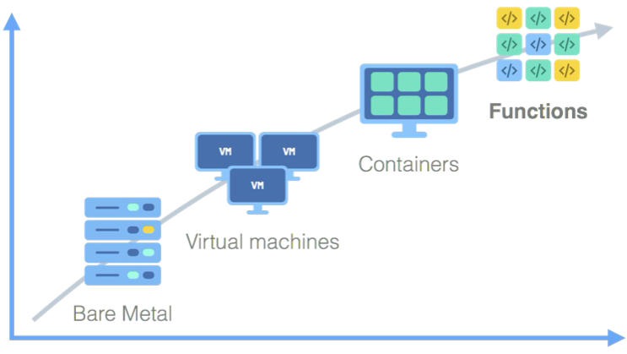

Serverless Computing and Function-as-a-Service: a Primer
IL METALLO!

Slide 3
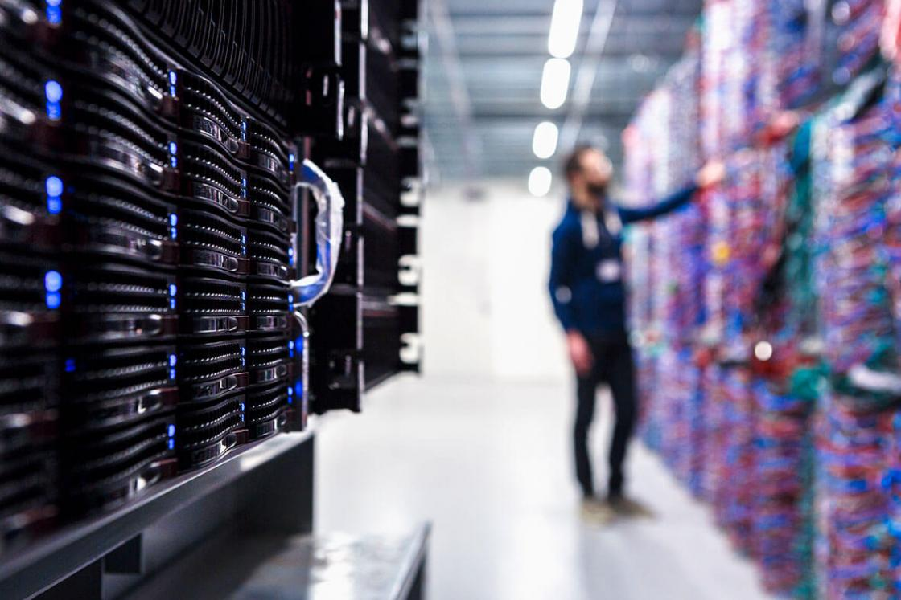

Slide 4
Serverless Computing and Function-as-a-Service: a Primer
The Cloud!

Slide 5
Serverless Computing and Function-as-a-Service: a Primer
The Cloud!
“It’s just somebody else’s computer!”
Cit.

Slide 6
Serverless Computing and Function-as-a-Service: a Primer
µS

Slide 7
Serverless Computing and Function-as-a-Service: a Primer
FaaS

Slide 8


Slide 9
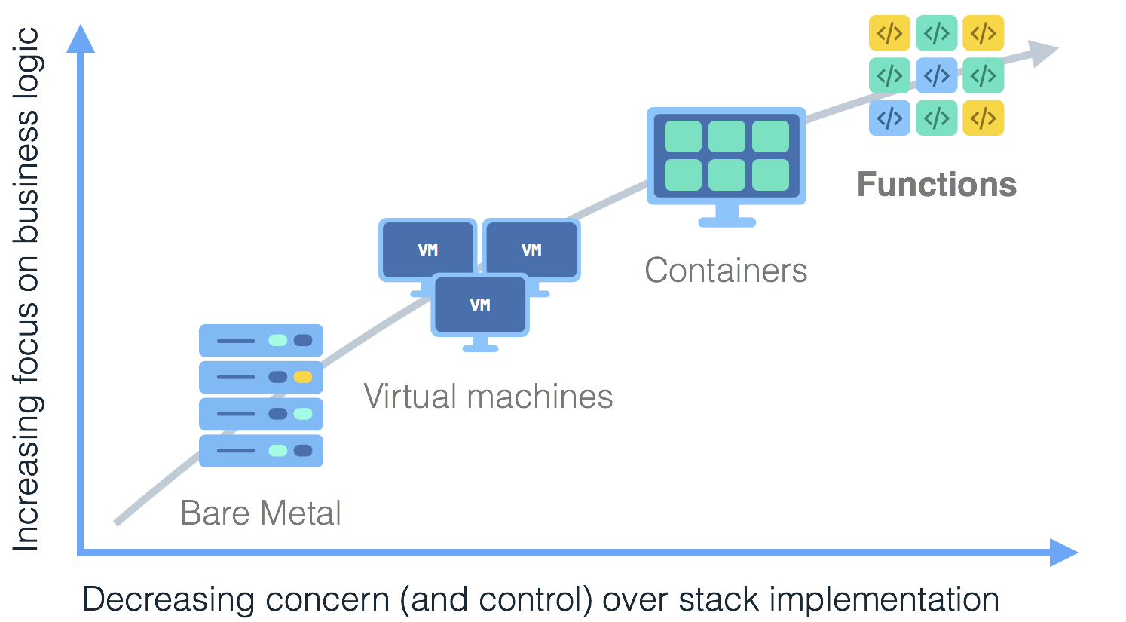
What is Serverless? Let’s start with BaaS
Long-running applications
Reaction to
events –
short lived
Notes:
Serverless is coming of age, developers want to focus on code instead of managing infrastructure.
Mention some of the companies.
Show the axis later.
Animate the arrow and boxes.

Slide 10
What is Serverless? Let’s start with BaaS
There is no single definition, two main cases:
First case (BaaS – Backend as a Service):
Serverless was first used to describe applications that significantly or fully incorporate third-party, cloud-hosted applications and services, to manage server-side logic and state.
cloud databases and message brokers (e.g.: Parse, Firebase, …)
authentication services (e.g.: Auth0, AWS Cognito)
many other service APIs…
These types of services have been previously described as “(Mobile) Backend as a Service" (BaaS)

Slide 11

What is Serverless? The case of FaaS
Second case, our main case (FaaS – Functions as a Service):
Serverless can also mean applications where the server-side logic is still written by the application developer, but, unlike traditional architectures, it runs in stateless compute containers in form of functions
These containers/functions (usually) are:
event-triggered,
ephemeral (may only last for one invocation), and
fully managed by a third party.
One way to think of this is “Functions as a Service” (FaaS) *.

Slide 12
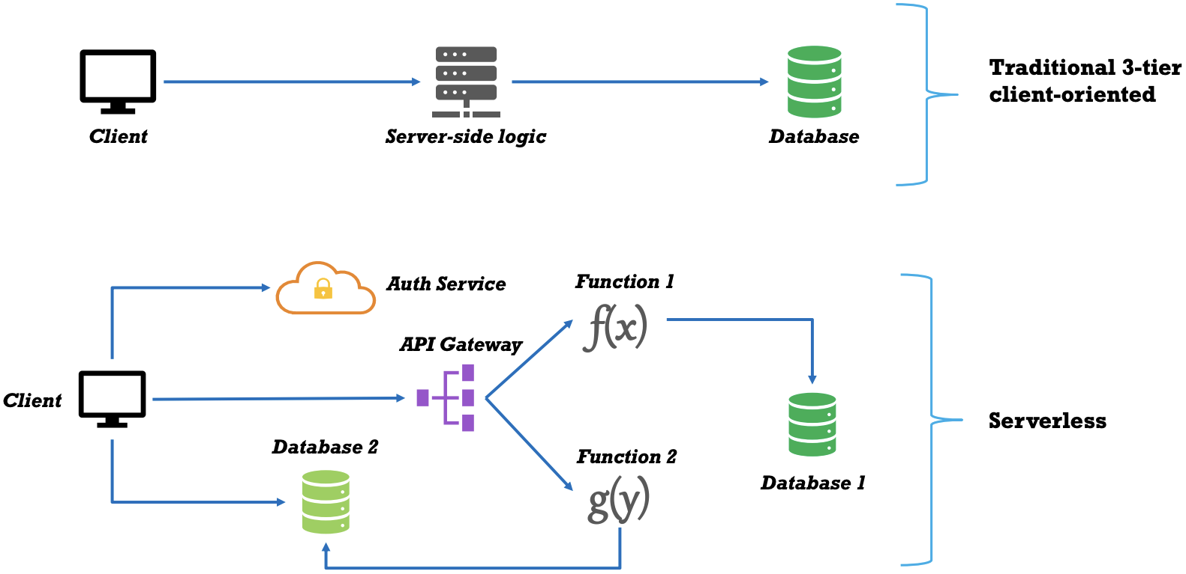
Learning by example: UI-driven applications - Traditional
Traditional three-tier client-oriented system with server-side logic (top)
Client mostly unintelligent
Logic in the system (authentication, page navigation, searching, transactions) implemented by the server-side application.

Slide 13
Learning by example: UI-driven applications - Serverless
Authentication as a Service (BaaS)
Direct access to a Database (e.g. Firebase)
Client has to be more intelligent
Server-side functionalities are are split
Instead of having an always-running server, as existed in the original architecture, FaaS functions respond to HTTP requests
The code is executed on demand and terminated soon afterward

Slide 14
Considerations
In the Serverless version there is no a central component.
Each component playing a more architecturally aware role: choreography over orchestration
Main properties:
Flexibility
Extendibility
Division of concerns
Cost reduction
But higher complexity

Slide 15
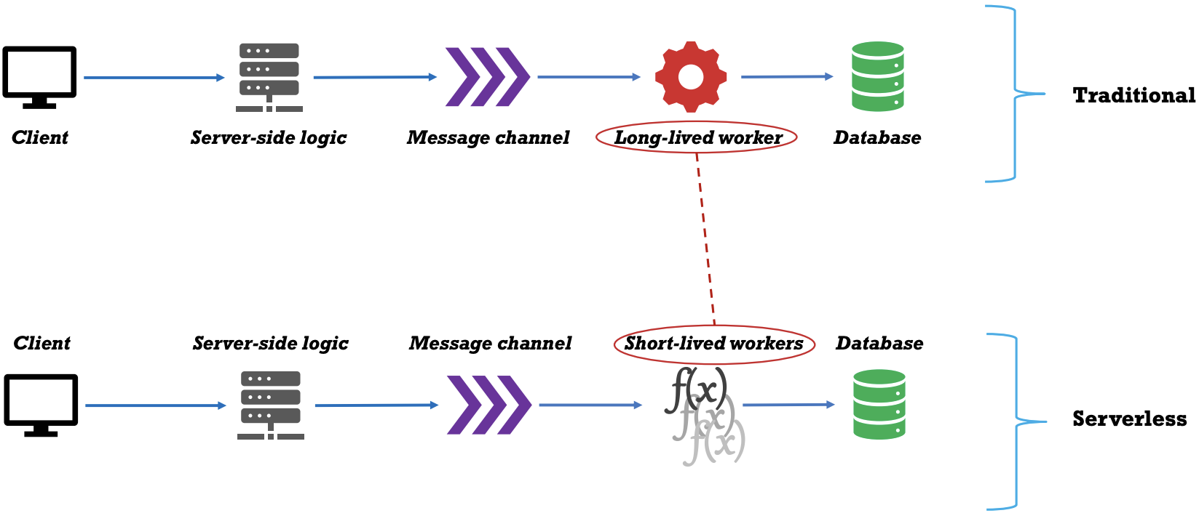
Example 2: Message-driven application
Traditional: Backend data-processing service
Long-lived service
Cost and maintenance
Example: Online advertisement system
when a user clicks on an ad you want to very quickly redirect them to the target of that ad.
The system must collect the fact that the click has happened to charge the advertiser

Slide 16
Example 2: Message-driven application
Serverless version:
Leaner architecture
Long-lived message-consumer application replaced with a FaaS function.
Event driven: the function is created and executed every time there is a message

Slide 17
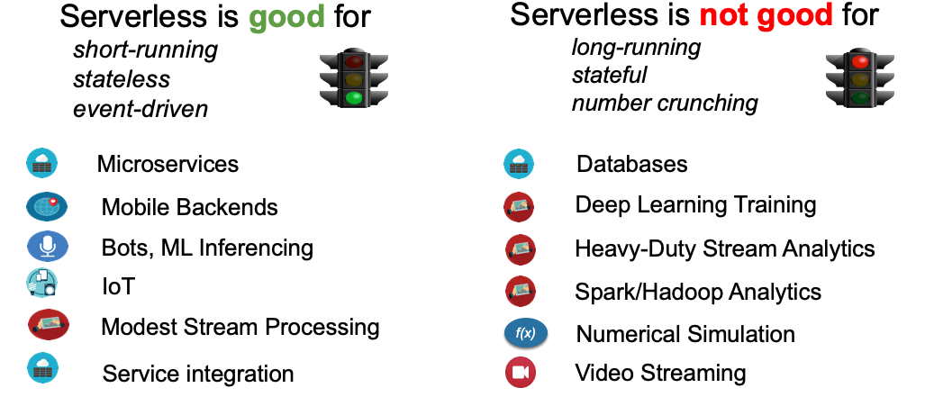
Takeaways

Slide 18
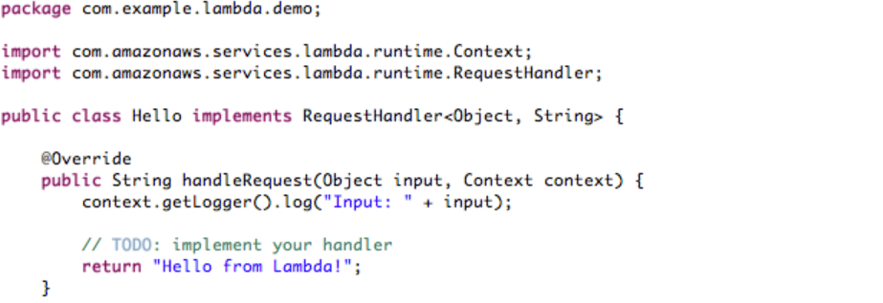
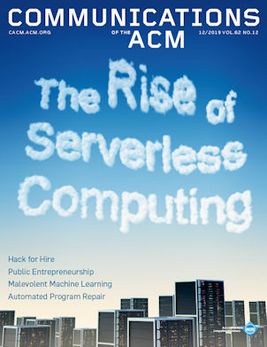
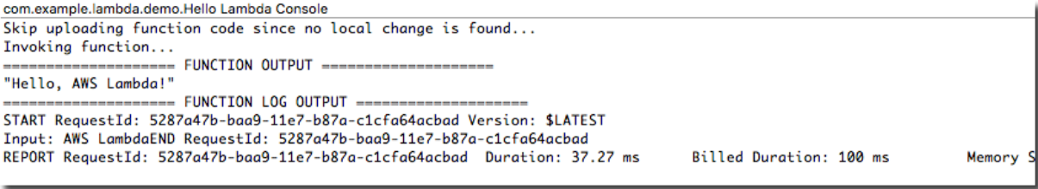
Serverless Function-as-a-Service
Serverless: seamless, easy-to-use, application logic without a client-server architecture
FaaS: function calls served from the cloud, event-driven paradigm
CACM - December 2019

Slide 19
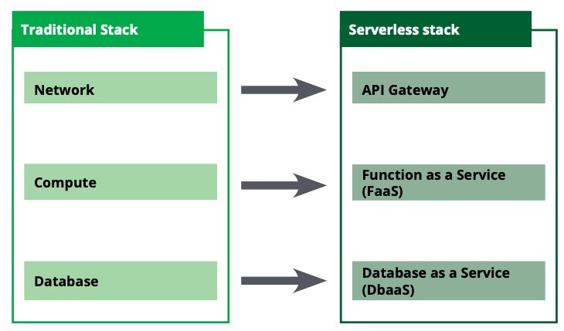
Key Differences & Benefits of FaaS vs. Traditional
Fully-managed service;
Event-driven by design;
Infinite scalability and built-in high-availability;
Less-Ops;
Pay-per-execute;

Slide 20

For Example: AWS Architecture – Lambda
Run code without servers:
Supports Node.js, Python, Java, C#, and Go;
Can use existing libraries;
Upload functions, then configure triggers;
Works closely with API gateway via proxy integration;
Functions reflect business logic and data access code;
Billed for compute cycles (function run-time);
VALUE PROPOSITION
How?

Slide 21
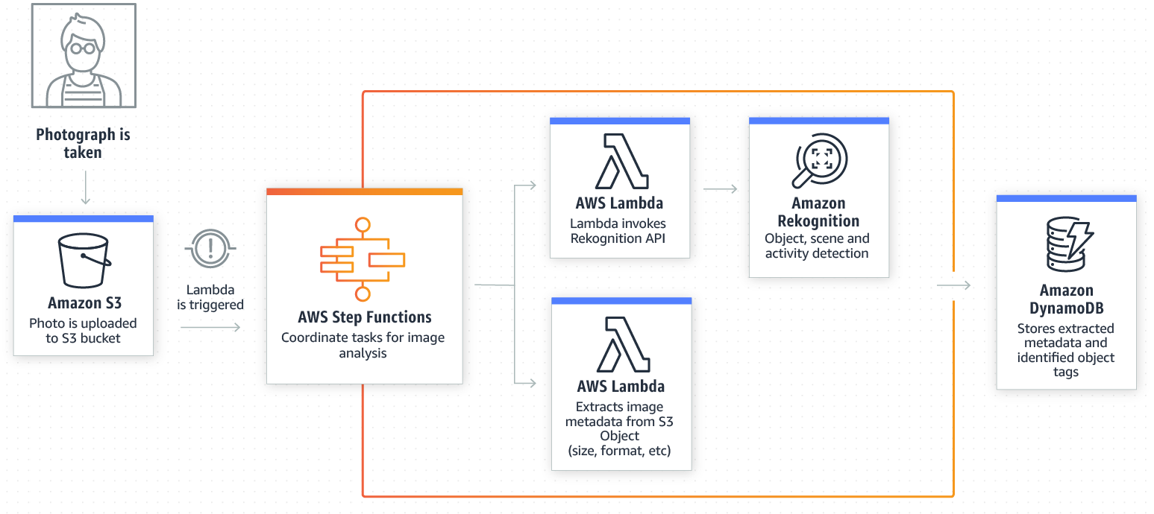
Thumbnail Generation
Notes:
https://www.simform.com/serverless-aws-lambda-examples/?utm_source=Twitter

Slide 22







For Example: Extract, Transform and Load (ETL) Data Pipelines
Arrival of Raw Data in datastore or message queue Triggers ETL pipeline
Serverless Platform
Transform
T
Fx
DB
Raw Data
Data-at-Rest
Enhanced Data
Queue
Streaming Data
Live Log data
IoT sensor data
Financial (market) data
In-Stream Analytics
e.g., TensorFlow
Data-in-Motion
Analyze, Annotate / Enhance
TensorFlow
Improved Data Integration for downstream consumers

Slide 23
No server to provision (nor roles and whatnot)
«AWS Lambda lets you run code without provisioning or managing servers».
FaaS is about running backend code without managing your own server systems or your own long-lived server applications.
A server isn’t needed, nor an application (in the server) that is running constantly.
No Server, VM, Container for long running applications
23

Slide 24
Subsecond metering
«You pay only for the compute time you consume - there is no charge when your code is not running».
With AWS Lambda, you are charged
for every 100ms your code executes and
number of times your code is triggered.
You don't pay anything when your code isn't running.
24

Slide 25
Language agnostic
«With Lambda, you can run code for virtually any type of application or backend service - all with zero administration».
FaaS offerings do not require coding to a specific framework or library. FaaS functions are regular applications.
AWS Lambda functions can be implemented in Javascript, Python, Go, any JVM language (Java, Clojure, Scala, etc.), or any .NET language.
Or any language that can compile down to a Unix process or a Docker container.
25

Slide 26
Resource provisioning
«Just upload your code and Lambda takes care of everything required to run»
Deployment is very different from traditional systems since we have no server applications to configure.
In a FaaS environment, we upload the code for our function to the FaaS provider, and the provider does everything necessary for provisioning resources, instantiating VMs, managing processes, etc.
26

Slide 27
Automatic scalability
«and scale your code with high availability.
Horizontal scaling is completely automatic, elastic, and managed by the provider.
If your system needs to be processing 100 requests in parallel the provider will handle that without any extra configuration on your part.
With FaaS the vendor handles all underlying resource provisioning and allocation—no cluster or VM management is required by the user at all.
27

Slide 28
Events
«You can set up your code to automatically trigger from other AWS services»
Functions in FaaS are typically triggered by event types defined by the provider.
Amazon AWS includes
S3 (file/object) updates,
time (scheduled tasks),
and messages added to a message bus.
28

Slide 29
http requests
«or call it directly from any web or mobile app.
Most providers also allow functions to be triggered as a response to an HTTP requests by using a component called API gateway.
29

Slide 30
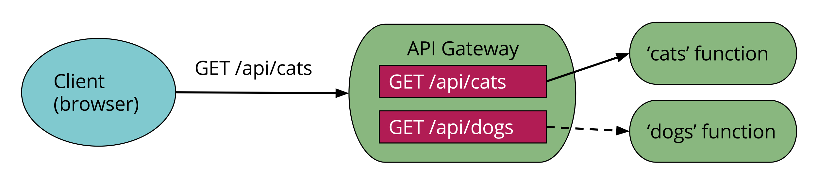
API Gateway
An API gateway is an HTTP server where routes and endpoints are defined in configuration, and each route is associated with a resource to handle (handler) that route.
In a Serverless architecture such handlers are often FaaS functions.
When an API gateway receives a request, it finds the routing configuration matching the request, and, in the case of a FaaS-backed route, will call the relevant FaaS function

Slide 31
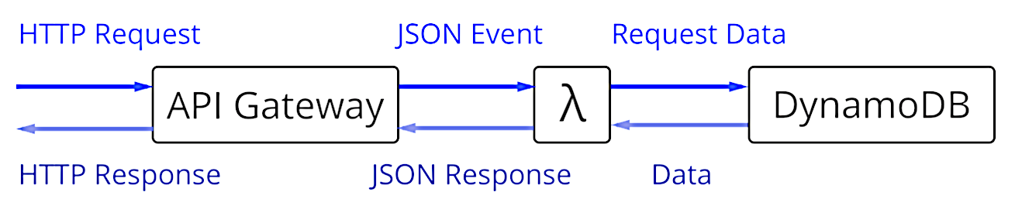

API Gateway
The FaaS function will execute its logic and return a result to the API gateway, which in turn will transform this result into an HTTP response that it passes back to the original caller.
Beyond purely routing requests, API gateways may also perform authentication, input validation, response code mapping, and more.
Amazon’s API Gateway is a BaaS service
service that you configure, but do not need to run or provision yourself.

Slide 32
Stateless, yes! No! well almost…
FaaS functions have significant restrictions when it comes to local state
Local state=data stored in variables in memory, or in a local disk.
There is no guarantee that such state is persisted across multiple invocations.
FaaS functions are described as stateless, but it’s more accurate to say that any state of a FaaS function that is required to be persistent needs to be externalized outside of the FaaS function instance.
32

Slide 33
Function duration
FaaS functions are typically limited in how long each invocation is allowed to run.
E.g., AWS Lambda function at most five minutes, before being terminated.
Long-lived tasks are not suited to FaaS functions
Trick: you may create several different FaaS functions, whereas in a traditional environment you may have one long-duration task

Slide 34

Startup latency
It takes some time for a FaaS platform to initialize an instance of a function before each event.
from a few milliseconds to several seconds
Initialization of a Lambda function will either be a:
warm start—reusing an instance of a Lambda function from a previous event
cold start —creating a new instance, starting the function host process, etc.
The Cold start could be a problem depending on
The programming language,
how many libraries are used in the function,
how much code you have in the function,
the configuration of the function environment

Slide 35
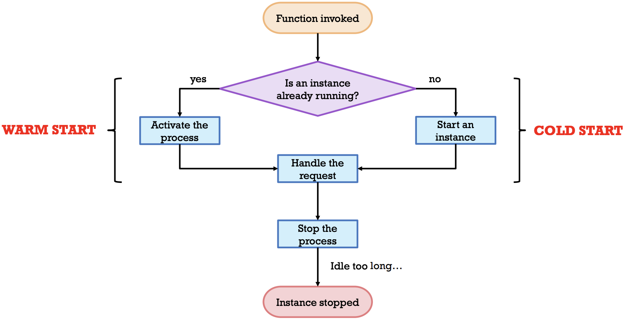
Function life-cycle

Slide 36
Open source in the FaaS world
Serverless Framework, which aims to make working with AWS API Gateway and Lambda easier than using the tools provided by AWS. It also provides an amount of cross-vendor tooling abstraction, which some users find valuable.
AWS’s own deployment tool, SAM—the Serverless Application Model—is also open source.
Apache OpenWhisk/ Open FaaS – open source FaaS platforms
Microsoft open sourced much of its Azure Functions platform

Slide 37
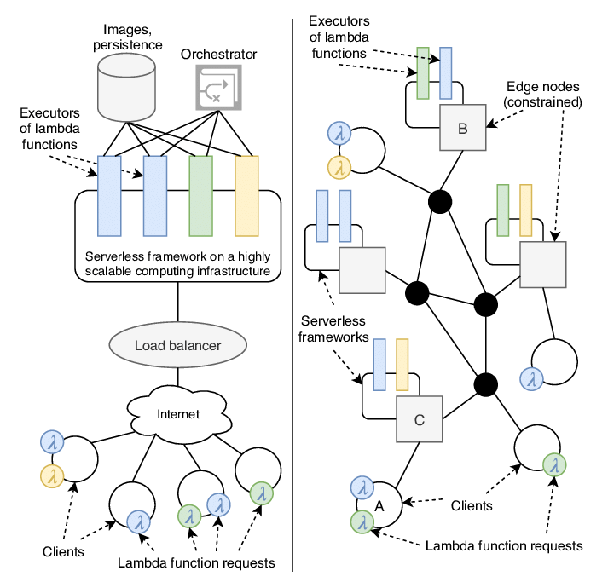
A real case, serverless
at
Company X

Slide 38


General Benefits
Reduced operational cost (Serverless is, at its most simple, an outsourcing solution)
Reduced development cost
A BaaS database removes much of the database administration overhead
Reduced packaging and deployment complexity
Reduced time to market and high flexibility
Reduced execution costs
unless you have a very steady traffic shape that uses the whole capacity of your server hosts, then you can save money using FaaS
Greener computing
Reduce inefficiency
38

Slide 39
Drawbacks
Vendor control
system downtime, unexpected limits, cost changes, loss of functionality, forced API upgrades
Multitenancy problems
Security, robustness, performance
Vendor lock-in
Execution duration
Startup latency
Testing, Debugging, Monitoring
Currently difficult or limited
39

Slide 40
How do I evolve µS into Serverless?

Slide 41
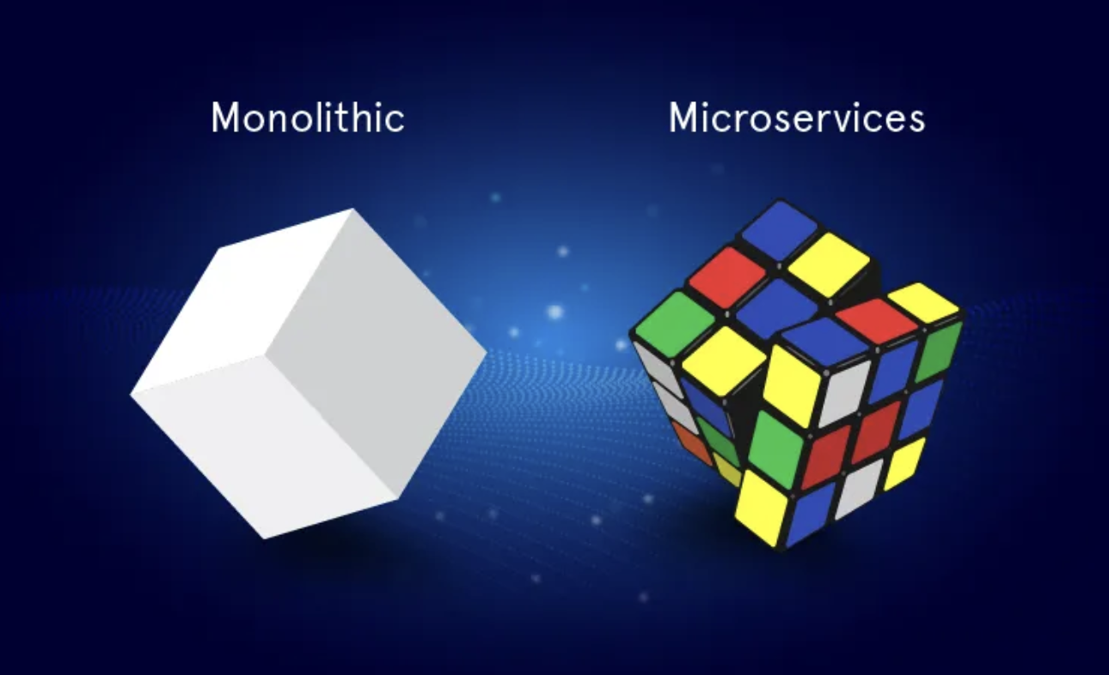

Slide 42
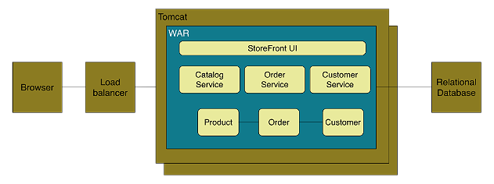
Context
Monolith Architecture Style
application deployed as a single artifact irrespective of internal structure
One of three cases:
All code share the same codebase and need to be compiled together
All deployment share same versioned code
The whole application is run under single server process
Figure: Online Store Example of Monolith Architecture

Slide 43
Context
Monolith Architecture Style
Advantages
Easy to develop and test
Deployment is easy
Scaling is clear and simple
Prompt reuse of components and functionalities
Disadvantages
Limited Agility due to difficult continuous delivery
Single codebase, deployment of small change needs whole application to be deployed
Affects continuous delivery, especially when multiple deployment per day
Decrease in Productivity due to understandability
Understanding of application is difficult due to overwhelming volume of codebase
Difficult Team Structure
Common ways by technology and geography
Communication and ownership not straight forward
Long-term Commitment to Technology Stack
Technology chosen during analysis phase
Limited Scalability due to unavailable option for scaling of individual units
Only one option ie, Horizontal Scaling
Independent scaling of components not possible

Slide 44
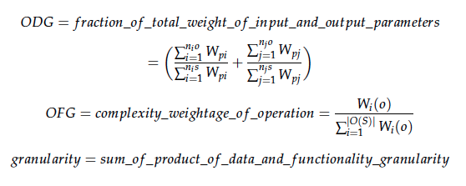
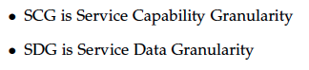
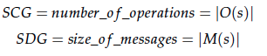
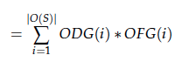
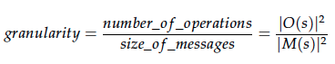
Granularity of a service is determined by the number of operations, type of parameters of operations and size of messages.

Slide 45
Good Microservice
Single Responsibility Principle
Microservices should be small and focused on doing one thing well [S.Newman and M. Stine]
“Gather together those things that change for the same reason, and separate those things that change for different reasons.” [16]
Single Responsibility Principle closely related to Coupling and Cohesion. [18, 19]
Autonomy [8, 20, 21, 22]
“The logic governed by a service resides within an explicit boundary” [24]
“ The service has control within this boundary and does not
depend on other services to execute its governance.
It also frees the service from ties that could inhibit its deployment and evolution” [23]
Techlology
The right value of granularity for an organization is highly influenced by its IT infrastructure. The organization should be capable of handling the complexities such as communication, runtime, infrastructure etc if they choose low granularity. [25, 26]

Slide 46
Quality Attributes for Services
# | References/Attributes | [13] | [27] | [15] | [14] | [28] | [29]
1 | Coupling | ✔ | ✔ | ✔ | ✔ | ✔ | ✔
2 | Cohesion | ✔ | ✗ | ✔ | ✔ | ✔ | ✔
3 | Autonomy | ✔ | ✗ | ✗ | ✗ | ✗ | ✗
4 | Granularity | ✔ | ✔ | ✔ | ✔ | ✔ | ✔
5 | Reusability | ✔ | ✗ | ✗ | ✔ | ✗ | ✔
6 | Abstraction | ✔ | ✗ | ✗ | ✗ | ✗ | ✗
7 | Complexity | ✗ | ✗ | ✗ | ✔ | ✗ | ✗

Slide 47
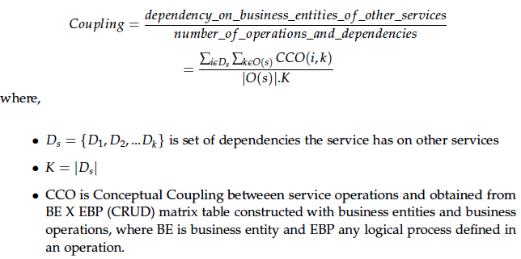
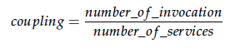
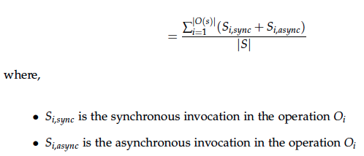
Coupling

Slide 48
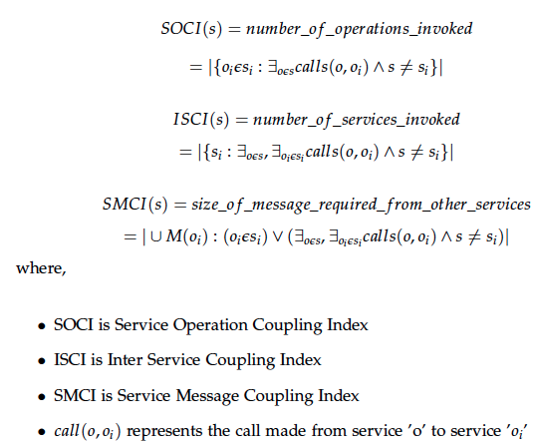
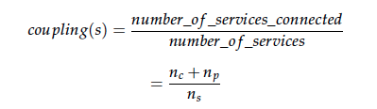
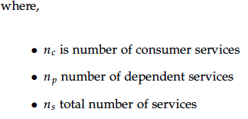
Coupling
Coupling in a service increases with the number of service invocations, number of dependent services and number of messages used.

Slide 49
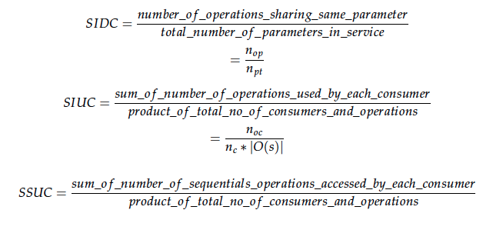
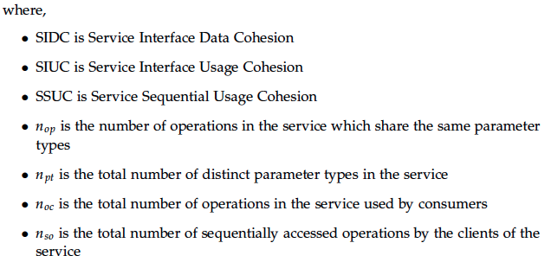
Cohesion

Slide 50
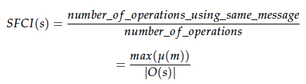
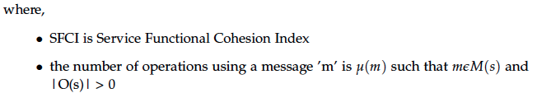
Cohesion
Cohesion is given by the number of operations sharing same messages, parameters and consumer.

Slide 51
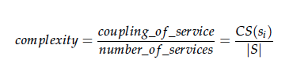
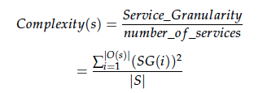
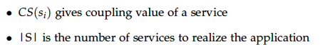
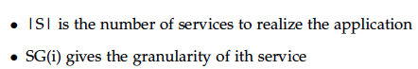
Complexity
Complexity of the service increases with granularity and coupling.

Slide 52
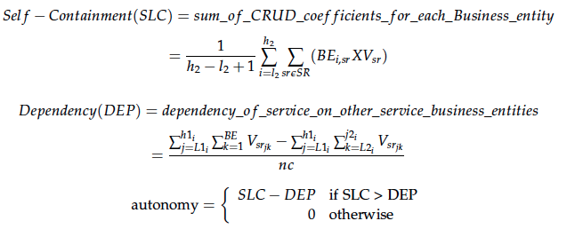
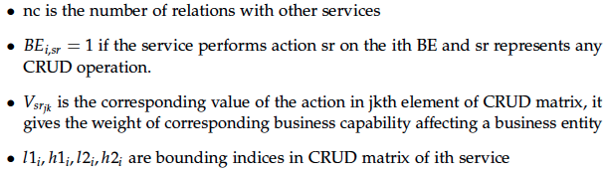
Autonomy
Autonomy of a service gives the degree of control of a service upon its business entities.

Slide 53
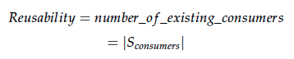
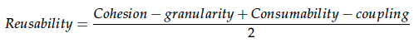
Reusability
Reusability increases with cohesion and consumers but decreases with granularity and coupling.

Slide 54
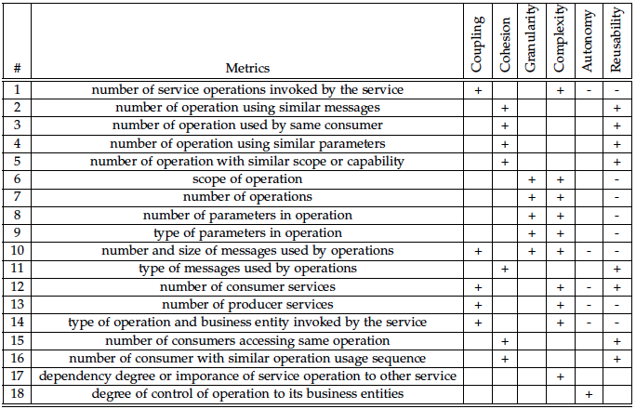
Basic Quality Metrics for Services

Slide 55
Microservice decomposition
Compute
App VM
App VM
device

Slide 56
Microservice decomposition
Application
Application
component
component
component
component
component
component

Slide 57
Microservice decomposition
container
container
container
container
container
container

Slide 58
Microservice decomposition
What I said I did
What management heard
but....

Slide 59
Microservice decomposition
overlays, underlays, tunnels, extending L2 etc etc

Slide 60
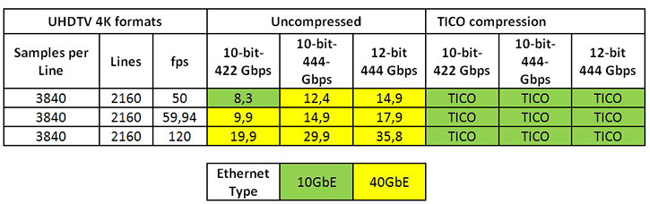
Chunky case - video
Uncompressed data rate = color depths * vertical resolution * horizontal resolution * refresh frequency

Slide 61
“Encoding in multiple formats in parallel including raw uncompressed per camera”
BBC: IP Studio project
… “Destination-timed switching is probably the simplest way to switch video on commodity Ethernet switches, but it generally requires twice the bandwidth of a single video signal to be reserved.”
Thomas Edwards of Fox, June 10, 2015, TVTechnology.com

Slide 62
Death by a thousand cuts case - distributed
“Compute is going to everywhere, …
... compute will be distributed from end points and in layers of networks before data is even shipped back into the datacenter...
..there could be as much processing outside the “server” and the “datacenter” as inside of it. These terms could become somewhat meaningless.”
- Peak X86, The Next Platform, Sep 15, 2016

Slide 63
Implications of reality...

Slide 64

Kubernetes 1.6 - 5,000 node 150,000 pod clusters
k8s
http://blog.kubernetes.io/2017/03/scalability-updates-in-kubernetes-1.6.html

Slide 65
Implications of containers

Slide 66
Key Problems
Choosing what to containerise and how is critical
Scale depends on alignment of choice vs. workload evolution!
µS manageability trade-off:
#(type, granularity)_{containers} vs. #(type, granularity)_{usage scenarios}
Contemporary evaluation of all aforementioned metrics…

Slide 67
Solution?

Slide 68
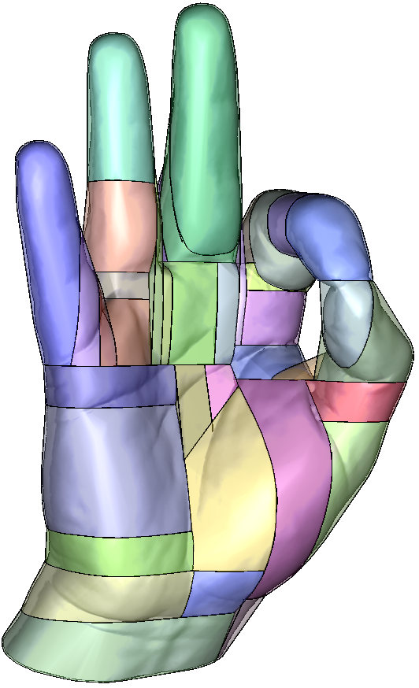

Slide 69
(…Automated decomposition…)

Slide 70
General Principles
Manageability & Observability first!
Single feature in single µS
Could be more than one operation
Operations are still disentangled
Decompose as much as you can for feature (not less)
Chorollary & compounding (ephemeral) features become serverless functions

Slide 71
One possible approach*: Microservices Identification through Interface Analysis
Core Assumptions:
* SOA reflects API’s (typically REST)
* Application exists (and must be evolved) or design specs are available to produce it
Idea:
* pair standardized (OpenAPI) specifications with homogeneous (shared vocabulary) semantic characterizations;
*Luciano Baresi, Martin Garriga, Alan De Renzis. Microservices Identification Through Interface Analysis. 6th European Conference on Service-Oriented and Cloud Computing (ESOCC), Sep 2017, Oslo, Norway. pp.19-33, 10.1007/978-3-319-67262-5_2 . hal-01677614

Slide 72
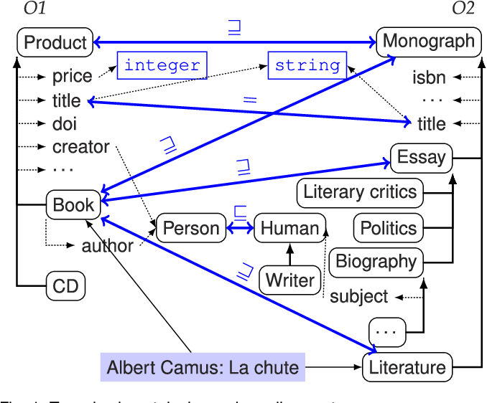
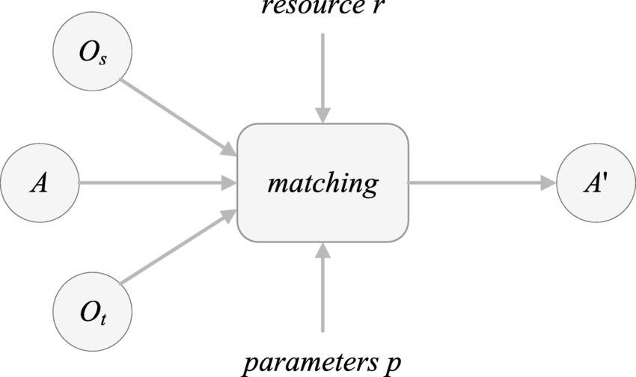
Sidebar: Semantic (i.e., ontology-based) matching

Slide 73
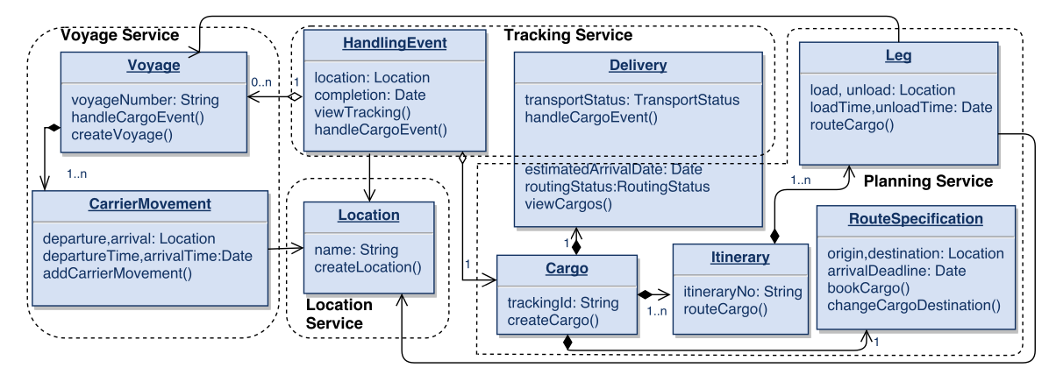
For example: the Cargo Tracking application*
Domain model and expected decomposition (dotted boxes)
*available on GitHub

Slide 74
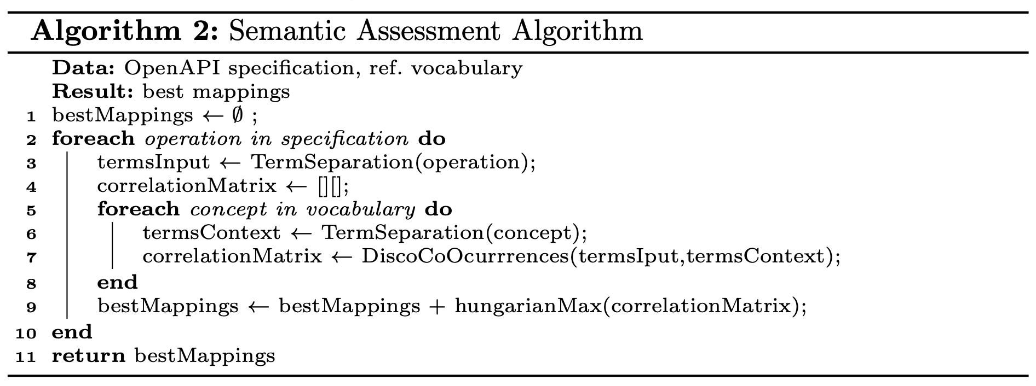
Semantic Matching

Slide 75
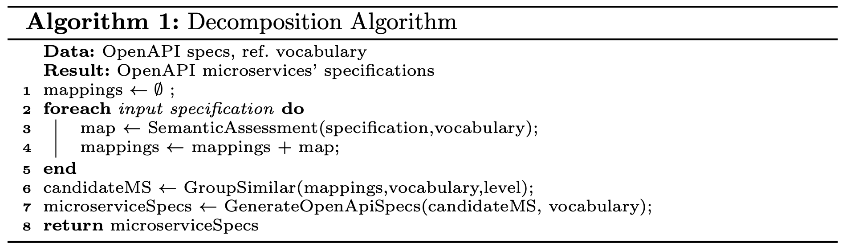
Decomposition

Slide 76
Decomposition

Slide 77
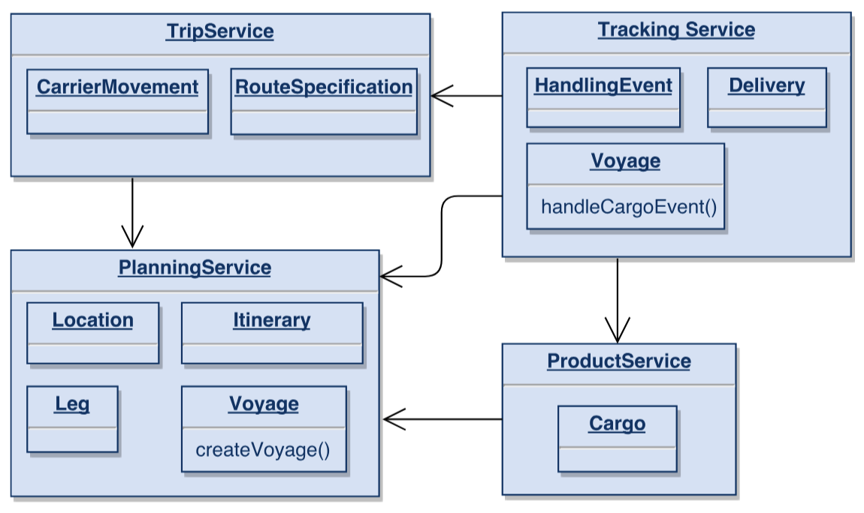
Result!

Slide 78
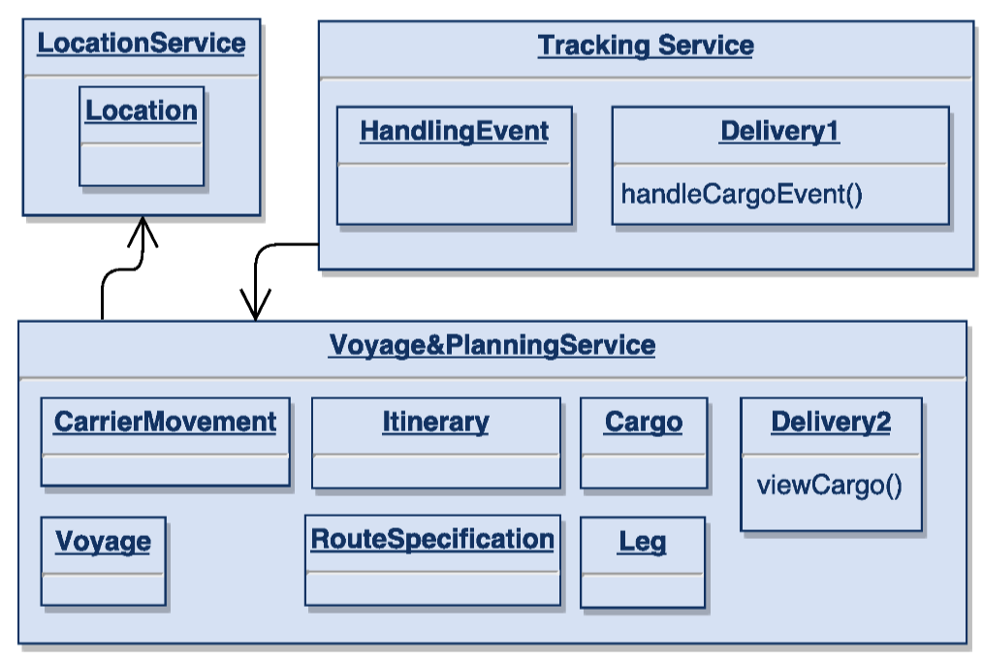
Other Result…

Slide 79
Which one is better?
Baresi et al.
ServiceCutter

Slide 80
One major flaw…
Is not driven by concerns/features of the overarching SOA!

Slide 81
One more flaw!
Why µS and not serverless functions?

Slide 82
A better approach: Utility-resolved evaluation*
You cannot decompose to µS directly, you evaluate utility of doing so!
A Clustering (or stronger ML approach) can aid utility evaluation/prediction!
* Zhu L, Tamburri DA, Casale G. RADF: Architecture decomposition for function as a service. Softw: Pract Exper. 2024; 54(4): 566-594. doi: 10.1002/spe.3276

Slide 83


Slide 84

The typical refactoring workflow

Slide 85

A better approach: Utility-resolved evaluation*
* Zhu L, Tamburri DA, Casale G. RADF: Architecture decomposition for function as a service. Softw: Pract Exper. 2024; 54(4): 566-594. doi: 10.1002/spe.3276

Slide 86

A better approach: Utility-resolved evaluation*
* Zhu L, Tamburri DA, Casale G. RADF: Architecture decomposition for function as a service. Softw: Pract Exper. 2024; 54(4): 566-594. doi: 10.1002/spe.3276

Slide 87

Final step… glue on top!

Slide 88
Pro’s & Con’s
+++++++++
Automated approach, can be tailored
Supposes iterative evolution process
Assumes gradual decomposition into smaller (still meaningful) components
Aids composability
--------------
Maximises utility, not manageability
Does not scale well
Does not work with (ultra)legacy systems, assumes decomp. monolith

Slide 89
Another Approach: Manual-first, Pattern-driven
Follow AST, decompose into serverless functions first, then µS
Only cluster functions together if they amount to same (conceptual) service or feature

Slide 90

Another Approach: Manual-first, Pattern-driven
Pattern 1 – sequential composition

Slide 91

Pattern 2 – API all
As examples but not limited to:
• Facade pattern
• Conditional chaining
• Map-reduce

Slide 92

Pattern 3 - Function Merging

Slide 93

Pattern 4 – Reflective Invocation

Slide 94

Pattern 5 - Continuous Passing

Slide 95

FaaS Platforms supporting these patterns

Slide 96
Take home read - “Decomposition of Monolith Applications into Microservices Architectures: A Systematic Review”

Slide 97


Slide 98
Bibliography
C. Richardson. Microservices: Decomposing Applications for Deployability and Scalability. May 2014
C. Richardson. Pattern: Monolithic Architecture. 2014. url: http://microservices.io/patterns/monolithic.html
R. Annett. What is a Monolith? Nov. 2014
M. Fowler and J. Lewis. Microservices. Mar. 2014. url: http://martinfowler.com/articles/microservices.html
Gupta. Microservices, Monoliths, and NoOps. Mar. 2015
S. Abram. Microservices. Oct. 2014. url: http://www.javacodegeeks.com2014/10/microservices.html
D. Namiot and M. Sneps-Sneppe. On Micro-services Architecture. Tech. rep.Open Information Technologies Lab, Lomonosov Moscow State University,2014
S. Newman. Building Microservices. O’Reilly Media, 2015
C. Richardson. Pattern: Microservices Architecture. 2014.
B. Wootton. Microservices - Not A Free Lunch! Apr. 2014. url: http://highscalability.com/blog/2014/4/8/microservices- not- a- freelunch.html.
A. Cockcroft. State of the Art in Mircroservices. Feb. 2015. url: http://www.slideshare.net/adriancockcroft/microxchg-microservices.
G. Radchenko, O. Taipale, and D. Savchenko. Microservices validation: Mjolnirrplatformcase study. Tech. rep. Lappeenranta University of Technology,2015
R. Sindhgatta, B. Sengupta, and K. Ponnalagu. Measuring the Quality of Service Oriented Design. Tech. rep. IBM India Research Laboratory
B. Shim, S. Choue, S. Kim, and S. Park. A Design Quality Model for Service-Oriented Architecture. Tech. rep. Sogang University, 2008
S. Alahmari, E. Zaluska, and D. C. D. Roure. A Metrics Framework for Evaluating SOA Service Granularity. Tech. rep. School of Electronics and Computer Science University Southampton, 2011.
http://programmer.97things.oreilly.com/wiki/index.php/The_Single_Responsibility_Principle
M. Stine. Jun. 2014. url: http://www.mattstine.com/2014/06/30/microservices-are-solid
E. Cobham Brewer url: http://www.objectmentor.com/resources/articles/srp.pdf
http://deviq.com/single-responsibility-principle/
J. Cramon. Feb. 2014 url: https://www.tigerteam.dk/2014/micro-services-its-not-only-the-size-that-matters-its-also-how-you-use-them-part-1/

Slide 99
Bibliography
J. Stenberg. Feb. 2015 url: http://www.infoq.com/news/2015/02/characteristics-microservices-ap
A. Rostampour, A. Kazemi, F. Shams, P. Jamshidi, and A. Azizkandi. Measures of Structural Complexity and Service Autonomy. Tech. rep. Shahid Beheshti University GC, 2011.
Y. Ma, H.X. Li, and P. Sun, "A Lightweight Agent Fabric for Service Autonomy," Springer, 2007, pp. 63-77.
P. Reldin and P. Sundling. Explaining SOA Service Granularity– How IT strategy shapes services. Tech. rep. Linköping University, 2007.
P. Herzum and O. Sims. Business Components Factory: A Comprehensive Overview of Component-Based Development for the Enterprise. John Wiley Sons, 2000
W. Xiao-jun. Metrics for Evaluating Coupling and Service Granularity in Service Oriented Architecture. Tech. rep. Nanjing University of Posts and Telecommunications
Q. Ma, N. Zhou, Y. Zhu, and H. Wang1. Evaluating Service Identification with Design Metrics on Business Process Decomposition. Tech. rep. IBM China Research Laboratory and IBM T.J. Watson Research Center, 2009
G. Feuerlicht and J. Lozina. Understanding Service Reusability. Tech. rep. University of Technology, 2007
Guidelines for performing Systematic Literature Reviews in Software Engineering.Tech. rep. Keele University, 2007
D. Foody. Getting web service granularity right. 2005.
A. Goeb and K. Lochmann. A software quality model for SOA. Tech. rep. Technische Universität München and SAP Research, 2011.
A. Gupta. Microservices, Monoliths, and NoOps. Mar. 2015.
R. Haesen, M. Snoeck, W. Lemahieu, and S. Poelmans. On the Definition of Service Granularity and Its Architectural Impact. Tech. rep. Katholieke Universiteit Leuven.
J. K. Lee, S. J. Jung, S. D. Kim, W. H. Jang, and D. H. Ham. Component Identification Method with Coupling and Cohesion. Tech. rep. Soongsil University and Software Quality Evaluation Center, 2001.
Q. Ma, N. Zhou, Y. Zhu, and H. Wang1. Evaluating Service Identification with Design Metrics on Business Process Decomposition. Tech. rep. IBM China Research Laboratory and IBM T.J. Watson Research Center, 2009.
M. Mancioppi, M. Perepletchikov, C. Ryan, W.-J. van den Heuvel, and M. P. Papazoglou. Towards a Quality Model for Choreography. Tech. rep. European Research Institute in Services Science, Tilburg University.
Y.-F. Ma, H. X. Li, and P. Sun. A Lightweight Agent Fabric for Service Autonomy. Tech. rep. IBM China Research Lab and Bei Hang University, 2007.
V. D. Naveen Kulkarni. The Role of Service Granularity in A Successful SOA Realization – A Case Study. Tech. rep. SETLabs, Infosys Technologies Ltd, 2008.

Slide 100
Bibliography
M. Perepletchikov, C. Ryan, K. Frampton, and Z. Tari. Coupling Metrics for Predicting Maintainability in Service-Oriented Designs. Tech. rep. RMIT University, 2007.
M. Perepletchikov, C. Ryan, and K. Frampton. Cohesion Metrics for Predicting Maintainability of Service-Oriented Software. Tech. rep. RMIT University, 2007.
C. Richardson. Microservices: Decomposing Applications for Deployability and Scalability. May 2014.
B. Shim, S. Choue, S. Kim, and S. Park. A Design Quality Model for Service-Oriented Architecture. Tech. rep. Sogang University, 2008.

Slide 101
Bibliography
Guerriero, M., Garriga, M., Tamburri, D. A. & Palomba, F. (2019). “Adoption, Support, and Challenges of Infrastructure-as-Code: Insights from Industry”. ICSME (p./pp. 580-589), IEEE.
D. A. Tamburri, F. Palomba, R. Kazman, (acc. 2019) “Success and Failure in Software Engineering: A Followup Systematic Literature Review”. IEEE Transactions on Engineering Management (to appear), IEEE.
Lipton, P., Palma, D., Rutkowski, M. & Tamburri, D. A. (2018). TOSCA Solves Big Problems in the Cloud and Beyond! IEEE Cloud Comput., 5, 37-47.
Casale, G., Artac, M., van den Heuvel, W.-J., van Hoorn, A., Jakovits, P., Leymann, F., Long, M., Papanikolaou, V., Presenza, D., Russo, A., Srirama, S. N., Tamburri, D. A., Wurster, M. & Zhu, L. (2020). RADON: rational decomposition and orchestration for serverless computing. SICS Softw.-Intensive Cyber Phys. Syst., 35, 77-87.
Cankar, M., Luzar, A. & Tamburri, D. A. (2020). Auto-scaling Using TOSCA Infrastructure as Code. In H. Muccini, P. Avgeriou, B. Buhnova, J. Cámara, M. Caporuscio, M. Franzago, A. Koziolek, P. Scandurra, C. Trubiani, D. Weyns & U. Zdun (eds.), ECSA Companion (p./pp. 260-268), : Springer. ISBN: 978-3-030-59155-7

Slide 102
References
Building Microservices - Designing Fine-Grained Systems Sam Newman
Designing for the Serverless Age https://gojko.net/2017/10/05/serverless-design-gotocph.html
Contino - Introduction to Serverless Computing with AWS Lambda
Learning Lambda - https://blog.symphonia.io/learning-lambda-part-8-addfab6b460d
Serverless Computing - Function as a Service Paul Castro, Vatche Ishakian, Vinod Muthusamy and Aleksander Slominski
102

